Slide 1
English
Unit 1 – My World
WALT: Express opinions, feelings and reactions.

Slide 2



WALT: Express opinions, feelings and reactions.
I can verbally express my own opinion.
I can explain why I have a certain opinion.
I can explain why others might not agree with my opinion.

Slide 3
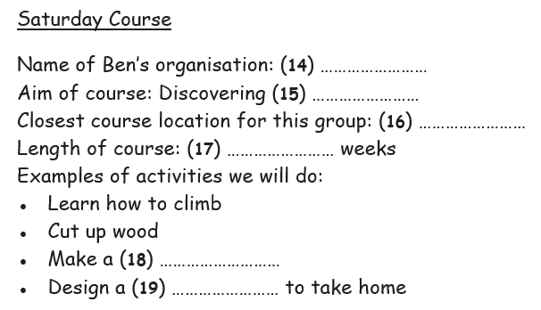
Retrieval Practice –
WALT: Express opinions, feelings and reactions.
https://englishpracticetest.net/practice-listening-test-for-b1-with-answer-and-audioscript-test-01/

Slide 4
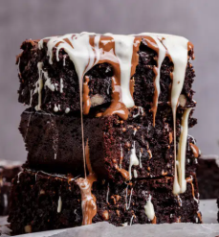
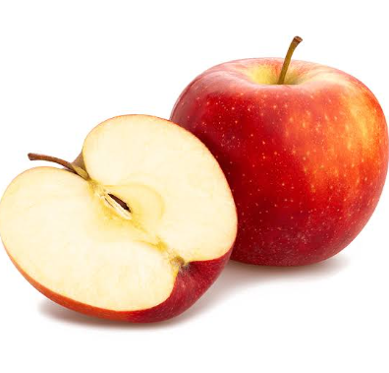
WALT: Express opinions, feelings and reactions.
Which do you prefer?
Tell your partner why.

Slide 5
WALT: Express opinions, feelings and reactions.
When giving your opinion, what do you need to include?
An explanation why!
Here is my opinion:
I love a chocolate brownie.
This is okay but it can be a lot better if I add an explanation why.

Slide 6
WALT: Express opinions, feelings and reactions.
My favourite dessert is a chocolate brownie. I love it because you can have a variety of toppings which add to the flavour and texture of the brownie. These sweet treats are also versatile meaning they can have different fillings like fruit.

Slide 7
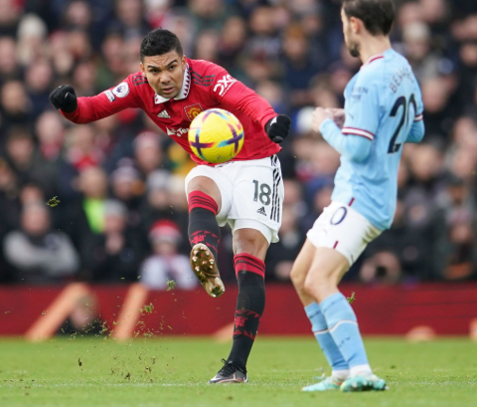

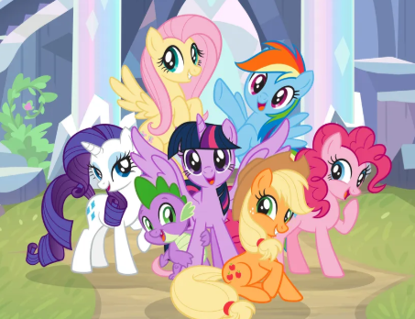

WALT: Express opinions, feelings and reactions.
Now, with your partner explain which you prefer using an explanation.
or
or

Slide 8
WALT: Express opinions, feelings and reactions.
Let’s share our opinions!
or
or

Slide 9
WALT: Express opinions, feelings and reactions.
It’s important when giving opinions to understand that other people might not agree with you and that’s okay!
We need to be able to explain the opinions of others.
Has anyone done this before?
For example:
My favourite sport is basketball. I like it because…
Other people might disagree with me by saying football is their favourite sport. This might be because…

Slide 10
WALT: Express opinions, feelings and reactions.
Let’s discuss…
Should we wear uniform in school or our own clothes?
Remember:
Explain your own opinion.
Explain why others might disagree with you.
I think that we should/should not wear a school uniform…
I think this because…
Other people might disagree with me because…

Slide 11
WALT: Express opinions, feelings and reactions.
I can verbally express my own opinion.
I can explain why I have a certain opinion.
I can explain why others might not agree with my opinion.

